Slide 1
Payroll management system
Group-6

Slide 2
Introduction
This document provides an overview of a payroll management system developed using the C++ programming language. The system automates tasks like employee data management, salary calculation, tax deductions, and payment processing, ensuring accuracy, efficiency, and data security. The system's architecture, key features, and functionality are detailed. Benefits of implementing a C++ payroll management system include improved productivity, cost savings, compliance with legal requirements, and enhanced employee satisfaction. The document also addresses potential challenges and considerations for successful implementation and maintenance. This resource is valuable for both organizations and software developers interested in payroll management system development.

Slide 3
Problem Statement
Problem: Manual Data Entry
Description: The current system requires manual data entry for adding employee details.
Solution: The code allows the user to add new employees by entering their details, eliminating the need for manual data entry. This reduces the chances of human errors and saves time.
Problem: Calculation Errors
Description: The current system lacks proper calculations for employee wages, taxes, pensions, and net salaries.
Solution: The code calculates the employee's weekly wage, tax amount, pension amount, and net salary based on the provided salary per hour and hours worked per day. This ensures accurate calculations and eliminates the risk of calculation errors.
Problem: Data Storage and Retrieval
Description: The current system does not provide a way to store and retrieve employee details.
Solution:The code calculates the employee's weekly wage, tax amount, pension amount, and net salary based on the provided salary per hour and hours worked per day. This ensures accurate calculations and eliminates the risk of calculation errors.

Slide 4
Problem: Data Storage and Retrieval
Description: The current system does not provide a way to store and retrieve employee details.
Solution: The code provides functionality to store employee details in a text file named "employees.txt". This ensures that the employee data is stored persistently and can be easily retrieved whenever needed.
Problem: Data Organization
Description: The current system lacks a structured approach to manage and organize employee data.
Solution: The code uses a class called "Employee" to define the attributes and functions related to an employee. This helps in organizing and managing the employee data in a structured manner.
Problem: Data Display
Description: The current system does not have a convenient way to view and verify employee information.
Solution: The code allows the user to display all the employee details stored in the text file. This makes it convenient to view and verify the employee information without manually searching through the file.

Slide 5
Pseduocode
start the program
Class Employee:
Properties:
- ID
- Name
- Position
- SalaryPerHour
- HoursWorkedPerDay
Methods:
- CalculateWeeklyWage()
- CalculateTax()
- CalculatePension()
- CalculateNetSalary()
- DisplayEmployeeDetails()

Slide 6
Main Function:
Initialize an empty list to store employee objects
While the user wants to add a new employee:
Create a new Employee object
Prompt the user to enter the employee details (ID, Name, Position, SalaryPerHour, HoursWorkedPerDay)
Set the employee object's properties based on the user input
Add the employee object to the list
Write the employee details from the list to a text file named "employees.txt"

Slide 7
Prompt the user to choose an option:
- If the user chooses to display all employee details:
Read the employee details from the "employees.txt" file
For each line in the file:
Split the line by the delimiter to extract the employee details
Create a new Employee object
Set the employee object's properties based on the extracted details
Call the DisplayEmployeeDetails() method to display the employee details
- If the user chooses to exit:
End the program

Slide 8
Flowchart

Slide 9
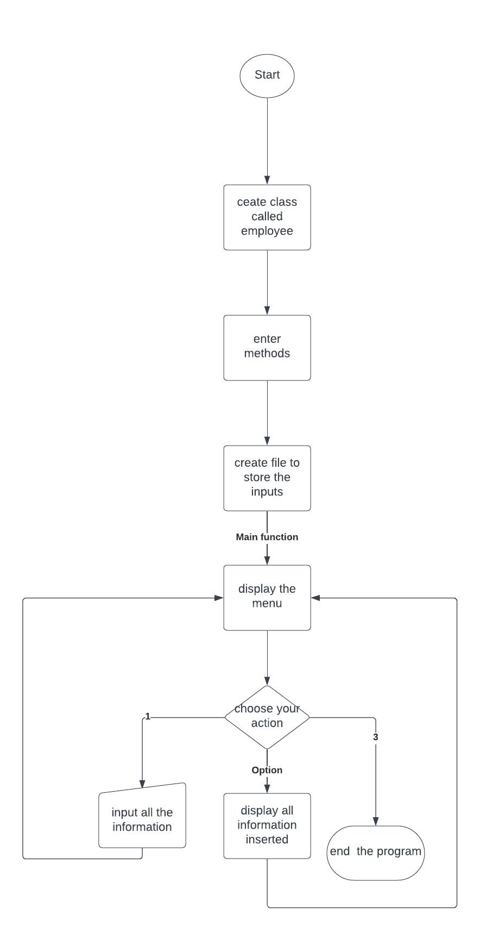

Slide 10
Let’s see the code….

